Slide 1


SEMESTER -05
ENGINEERING CLINICS
PROJECT FALLSEM 2022-23 REVIEW - 02

Slide 2
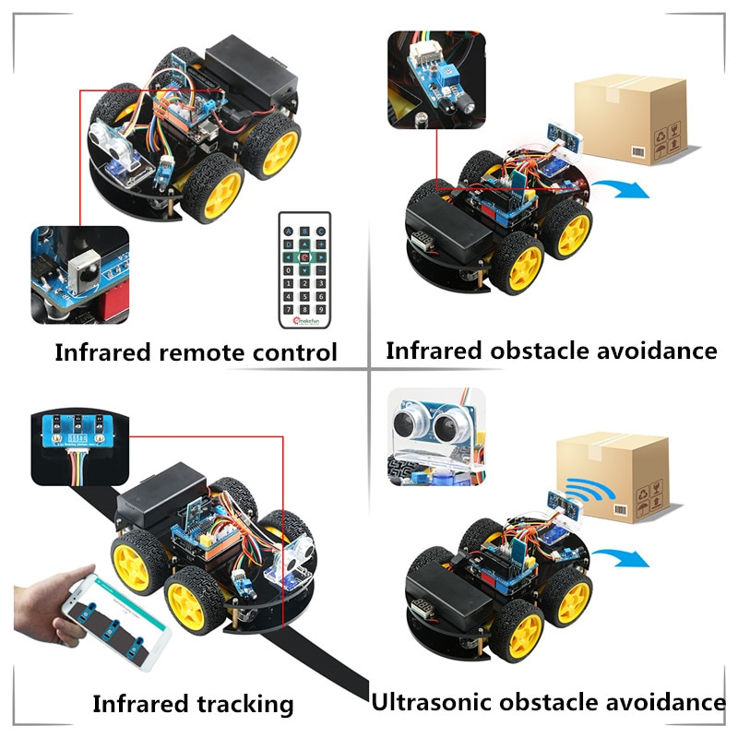

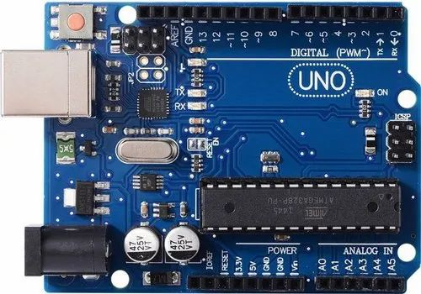
SMART ROBOT CAR USING ARDUINO
Android based smart robot control car

Slide 3



GUIDE NAME
PROF. NEERAJ KUMER MISRA
TEAM MEMBERS
ARUMULLA YASWANTH REDDY -20BES7010
DAMARLA BHUVAN SRI SAI -20BCD7096
KAKUMANU SRIMANI -20BCD7133
NUTHALAPATI JASHVIKA-20BCD7115
CHANDINI KOLLATI -20BCE7379
KANDUKURI PRANAVI-20BCR7104

Slide 4
Agenda
Problem Definition
Circuit Diagram
Overall Flow Diagram
Bluetooth car flowchart module
Infrared obstacle avoidance flowchart module
Line tracking car flowchart module
Finder function software design flow chart
Target Achievement during 30-Sep-22 to 25-Dec-2022
Robot Car IO Pin Connection Table
Each parts of car
TimeLine Chart
References

Slide 5


Problem Definition
This project is aims at developing Arduino based smart robotic control to provide a better solution to society.
In this modern digital world, everyone is moving towards automation Robotics allows automation where machines perform a well-deﬁned step safely and productively, in autonomous or partial autonomous manners.
A number of robot car bases are available for just such a project. These inexpensive bases are generally made of acrylic and come complete with a set of small DC motors.

Slide 6
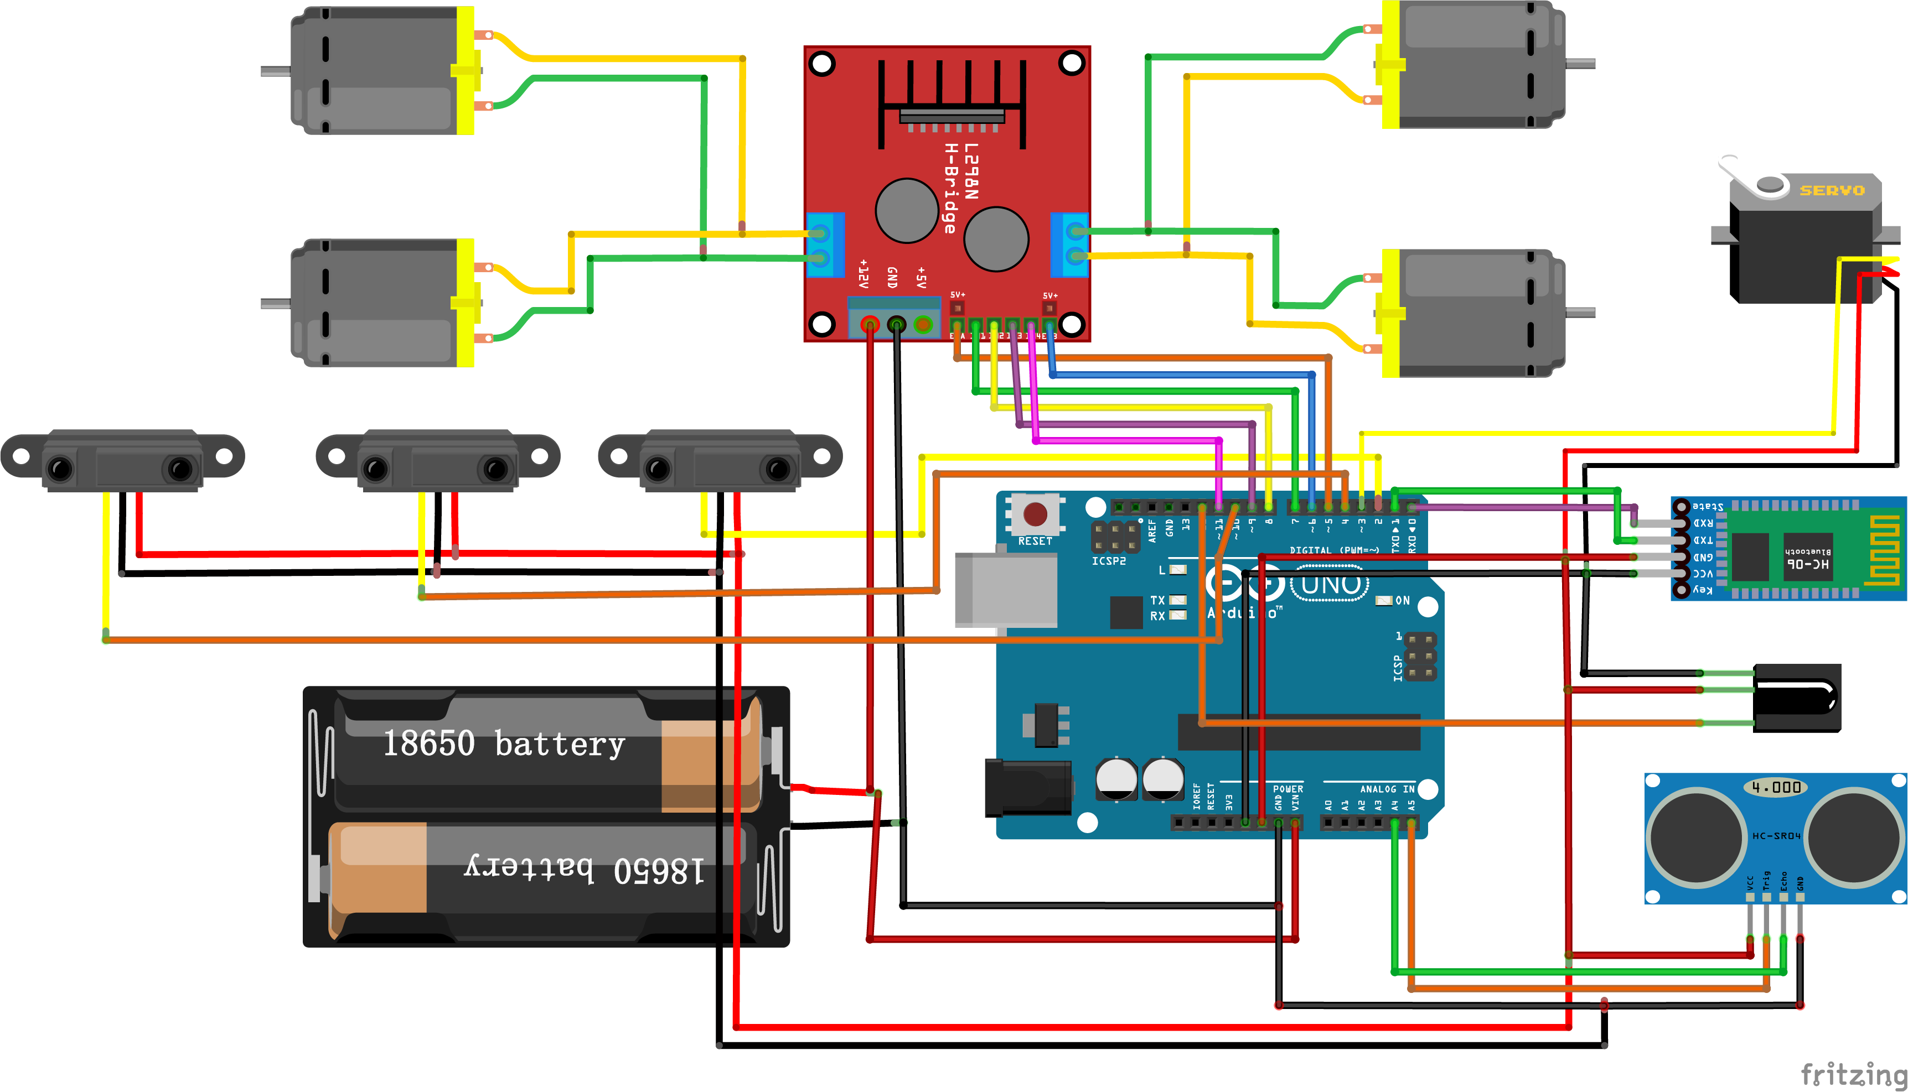
Circuit Diagram

Slide 7
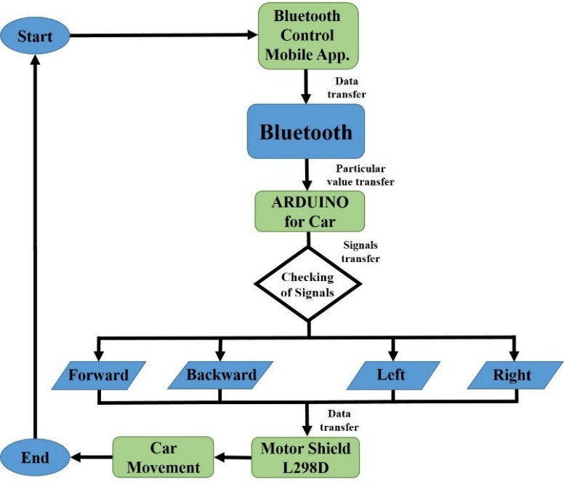
Overall Flow Diagram
Bluetooth car flowchart module

Slide 8
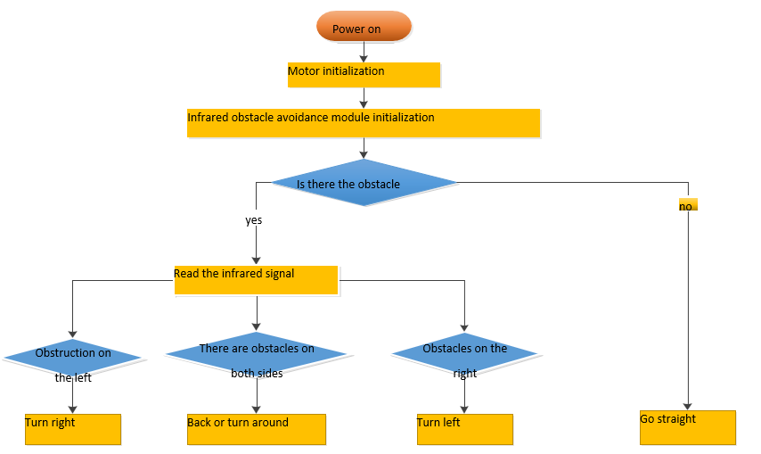
Overall Flow Diagram
Infrared obstacle avoidance flowchart module

Slide 9
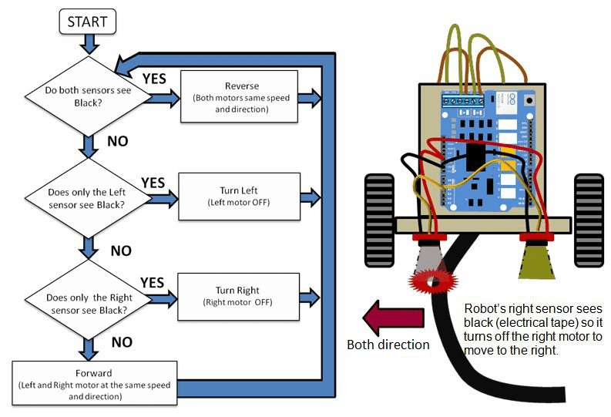
Overall Flow Diagram
Line tracking car flowchart module

Slide 10
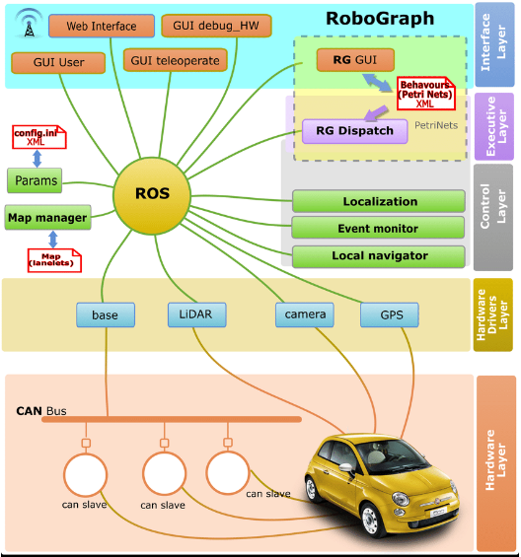
Overall Flow Diagram
Finder function software design flow chart

Slide 11
Target Achievement during 30-Sep-22 to 25-Dec-2022
Up to Review 1 – Requirement Identification , Designing the System,
Schematic diagram of overall connection
Up to Review 2 - Module Implementation
Project Design – Completed
Circuit Diagram - Completed
Overall Flow Diagram-Completed
Testing – Yet to Completed
Up to Review 3 – Completed Execution With Demo
Participating in Expo to demonstrate the prototypes

Slide 12
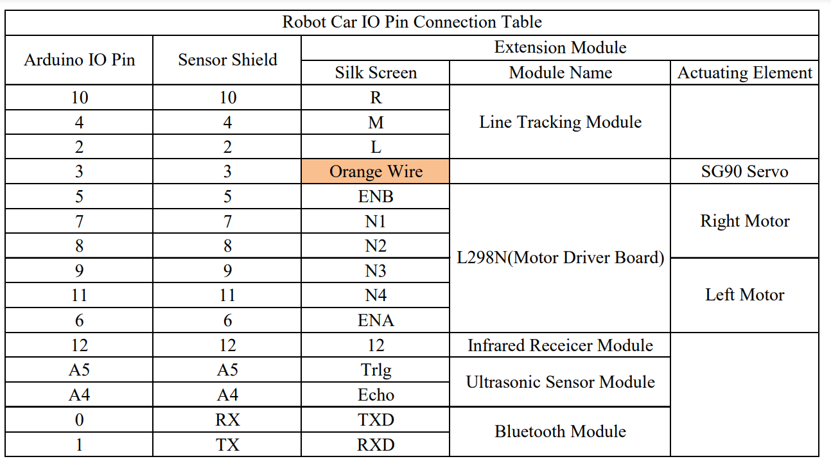
Robot Car IO Pin Connection Table

Slide 13
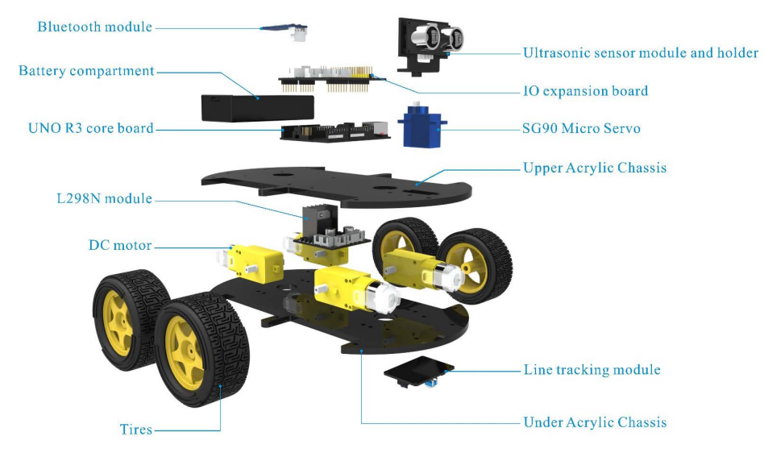
Each parts of the car is as below

Slide 14
TimeLine Chart
Delivery
Testing
Integration
Coding – Arduino Uno
Hardware Analysis
Pbm Identified
Literature Survey
Modules | Sep 1st to 4thWeek | Oct 1st Week |  | Oct 2nd Week | Oct 3rd Week | Oct 4th Week | Nov 1st Week | Nov 2nd Week | Nov 3rd Week | Nov4thWeek | Dec 1st to 4thWeek

Slide 15




REFERENCE
https://www.scribd.com/books
https://www.scribd.com/document/449237250/Hummer-Bot-4-0-Instruction-Manual-V-1-5
https://create.arduino.cc/projecthub/samanfern/bluetooth-controlled-car-d5d9ca

Slide 16

THANK YOU

